Slide 1
British Airways
Customer Review Insights

Slide 2
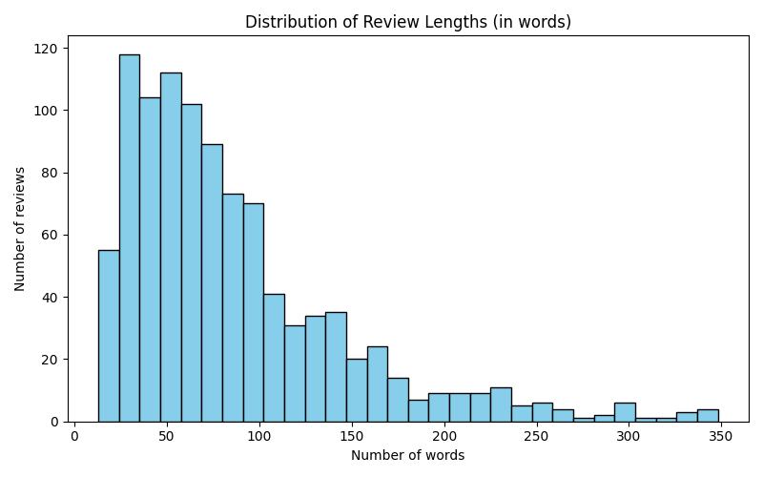
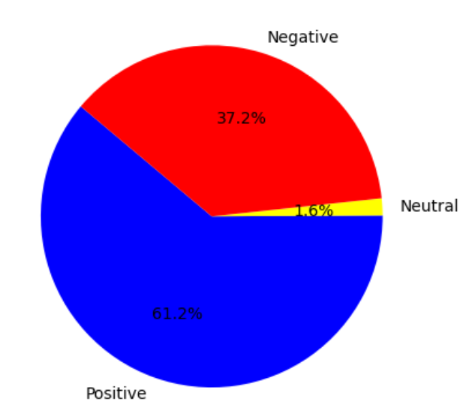
Sentiment Analysis
Review Lengths
Most reviews are between 20 and 100 words, peaking at around 30–50 words.
Customers appreciate crew service and flight comfort.
Main negative points: baggage handling, flight delays.
Opportunity: Improve punctuality and baggage process.
Count of Reviews
Positive: 612
Neutral: 16
Negative: 372

